Slide 1


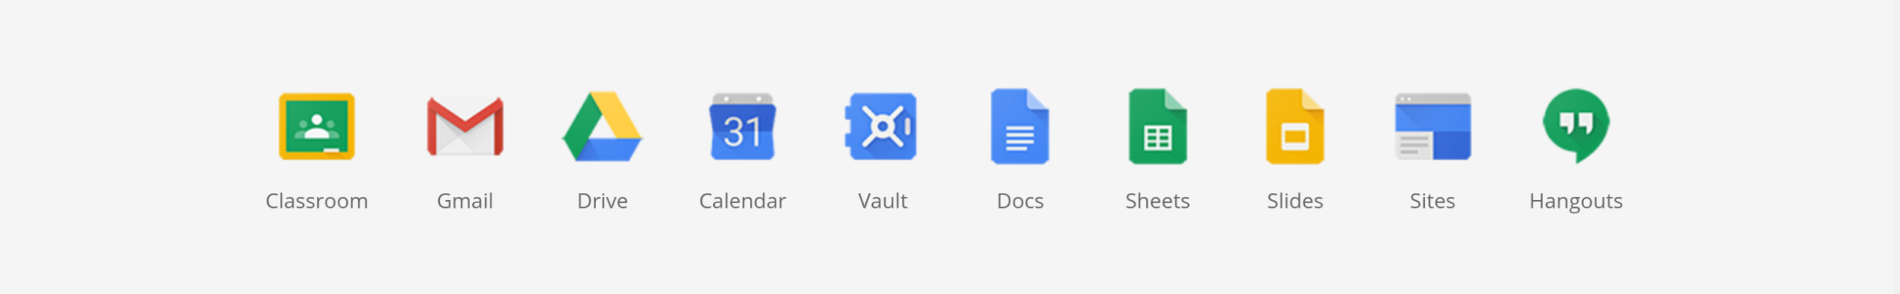
Google for Education offering
Chromebooks
Google Admin
G Suite for Education
Notes:
Chromebooks
Google Admin and Chrome Management Console
G Suite for Education
Set of tools for content creation and sharing, collaboration and communication
Personalized domain.
Totally free for schools! And also saves IT costs!
Unlimited storage space per user.
Multi device.
Totally safe

Slide 2
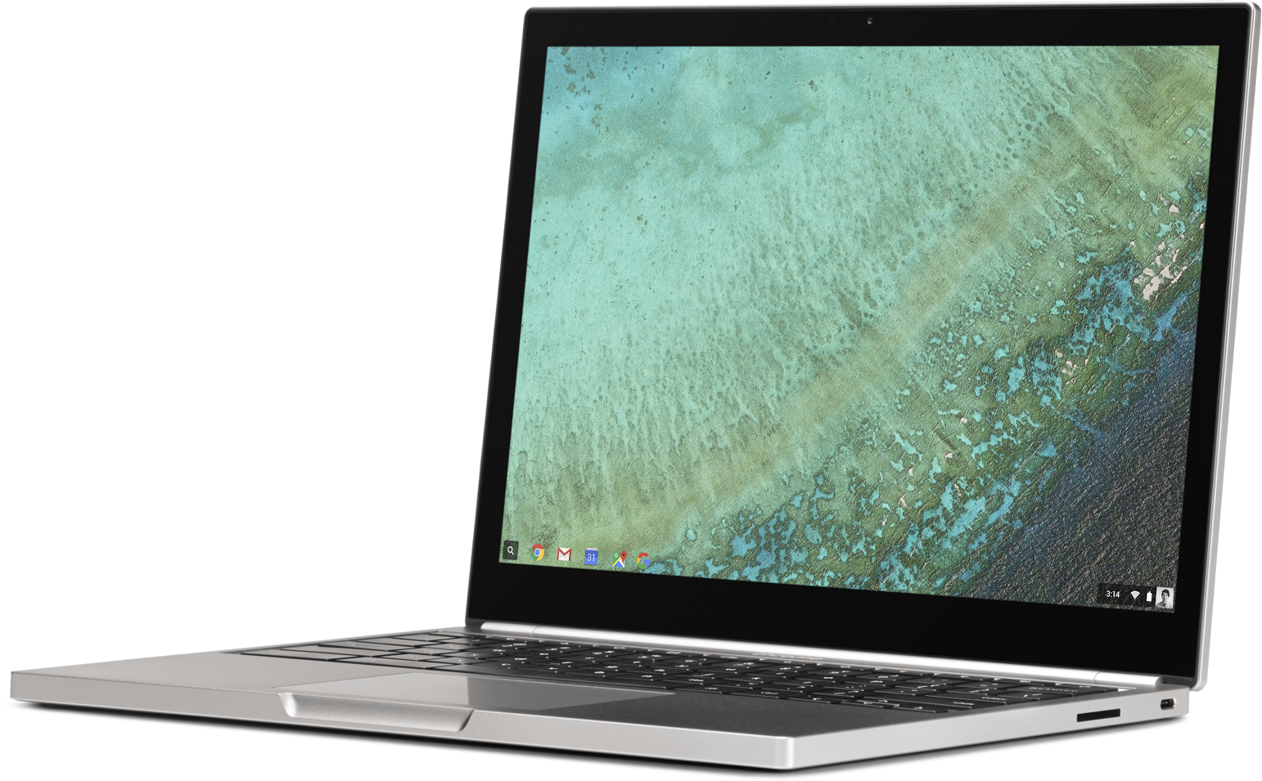
What is a Chromebook?
Designed for learning,
made for the classroom
Lightweight, durable laptops
designed for students
Boot up in less than 6 seconds and battery lasts the whole day
Automatic updates
Notes:
Lightweight, shock resistant
Fast: Boot in 6 seconds; long battery life
Automatic free updates for the life of the device. These updates make your CB run faster, and not slower.

Slide 3
Key differentiators
Simple
Affordable
Secure
Shareable
Notes:
Simple
to deploy and use (1 or 10k…)
Cloud experience: personalized (applications, wallpaper, settings, etc.) per user, no matter which device they use.
Work online and offline
Run Android apps...
Generally cheaper than other kind of computers due the free license from Google
Safest computer. All local information is stored in a sandbox. All cloud information is stored in the safest data centers. All connections are encrypted.
These can be multi-user computers, and can switch users in a matter of seconds. All personal information from each user is secure.

Slide 4
Google Admin
Create users and groups
Enforce
policies
Configure device settings at scale
Lock / disable
devices
Install apps remotely
Kiosk mode for assessments
Manage hardware
Notes:
Google Admin:
Create users, org units, groups, for schools and classrooms. Each user will have an account with email, drive, etc.
Enforce policies to grant or deny access to some tools, configure each tool, etc.
Configure remotely each device (WiFi, certificates, proxy, etc.) 1 or 10k at once…
Block or disable a stolen device remotely
Install applications to thousands of computers at once; customize Chrome Web Store
Block other sites that the test in kiosk mode
Manage hardware features (disable the webcam, USB, etc.)

Slide 5
Links:
https://goo.gl/CY47mG
Notes:
Simple
to deploy and use (1 or 10k…)
Cloud experience: personalized (applications, wallpaper, settings, etc.) per user, no matter which device they use.
Work online and offline
Generally cheaper than other kind of computers due the free license from Google
Safest computer. All local information is stored in a sandbox. All cloud information is stored in the safest data centers. All connections are encrypted.
These can be multi-user computers, and can switch users in a matter of seconds. All personal information from each user is secure.

